Slide 1
Computing Basics for Bioinformatics in R
Yaoyu Wang
Notes:
Unix/Cloud Basics/IGV installation

Slide 2
Overview
What is R
Basic IO and data type
Data type manipulation
Set operation

Slide 3
What is R?
• Programs for statistical analysis
- SAS, SPSS, STATA, …
• Programming Language
- Assembly, FORTRAN, COBOL->B, C, S -> C++, JAVA
- S = statistical programming language
developed by Bell Labs in the late 70s
• Evoluation of S
– S-Plus
– R : Free & open source implementation of S
• We can use R for Free!!.
Notes:
In other words, this is a collection/group of integrated and networked hardware, software and Internet infrastructure (called a platform).
Using the Internet for communication and transport provides hardware, software and networking services to clients.
These platforms hide the complexity and details of the underlying infrastructure from users and applications by providing very simple graphical interface or API (Applications Programming Interface).

Slide 4
What is R?
• slow / fast
– Interpreted language : R, BASIC
– Compiled language : C, FORTRAN
• easy
– Great help manual
– Many web resource..(https://stat.ethz.ch/mailman/listinfo/r-help )
• Extensible
– Cross-platform: can run anywhere
• lots of libraries
• Can execture C, Fortran through Dynamic Link Library
• CRAN & Bioconductor
Notes:
In other words, this is a collection/group of integrated and networked hardware, software and Internet infrastructure (called a platform).
Using the Internet for communication and transport provides hardware, software and networking services to clients.
These platforms hide the complexity and details of the underlying infrastructure from users and applications by providing very simple graphical interface or API (Applications Programming Interface).

Slide 5
What is R?
Basic of R
• R
– Basic programming
– Using packages
• stats
• Good reference
– http://www.r-project.org/
Notes:
In other words, this is a collection/group of integrated and networked hardware, software and Internet infrastructure (called a platform).
Using the Internet for communication and transport provides hardware, software and networking services to clients.
These platforms hide the complexity and details of the underlying infrastructure from users and applications by providing very simple graphical interface or API (Applications Programming Interface).

Slide 6
What is R?
• Programs for statistical analysis
- SAS, SPSS, STATA, …
• Programming Language
- Assembly, FORTRAN, COBOL->B, C, S -> C++, JAVA
- S = statistical programming language
developed by Bell Labs in the late 70s
• Evoluation of S
– S-Plus
– R : Free & open source implementation of S
• We can use R for Free!!
Notes:
In other words, this is a collection/group of integrated and networked hardware, software and Internet infrastructure (called a platform).
Using the Internet for communication and transport provides hardware, software and networking services to clients.
These platforms hide the complexity and details of the underlying infrastructure from users and applications by providing very simple graphical interface or API (Applications Programming Interface).

Slide 7
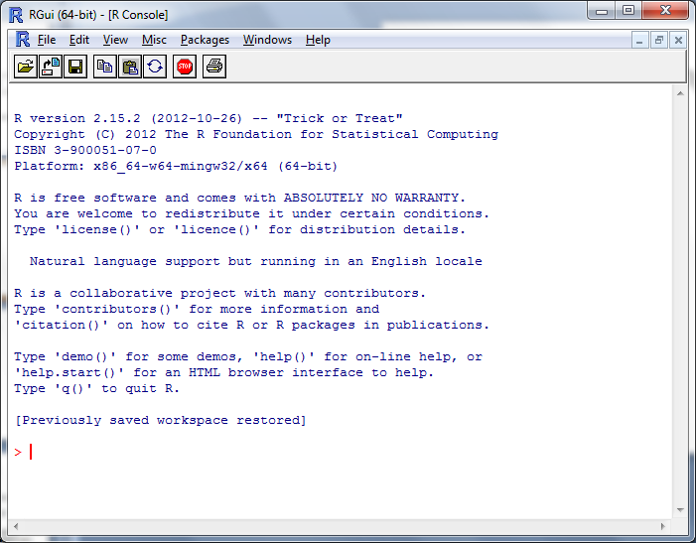
Starting R

Slide 8
Basic Data types
Scalar
Vector
Matrix
List
Dataframe
Factor

Slide 9
Basic Data types
Data type : Scalar
A single variable of numeric, character, and logical type
e.g. a=10 a variable a with value 10
Data type : Vector
Statistical data = a set of (random) variables
It can uniformly contain numeric, character, and logical values
e.g. a=c(1,2,3,4) or a=c(“a”, “b”, “c”,”d”)

Slide 10
Basic Data types
Data type : Matrix
A set of vectors with the same length and same scalar data type
Example: A 2x2 matrix
> mdat =matrix(c(52,2,77, 11), nrow = 2, ncol=2, byrow=TRUE)
> mdat
 | [,1] | [,2]
[1,] | 52 | 2
[2,] | 77 | 11

Slide 11
Basic Data types
Data type : List
An object that contains a LIST of other objects
Example:
A=5
B=c(1,2,3,4)
C=list()
mylist=list(A,B,C,D=“test”)
mylist[[1]] # equal 5
mylist[“A”] # equal 5 as well
“A”
Vector
”B”
Matrix
“C”
List

Slide 12
Set operation of vectors
X
Y
> xy=union(x,y)
> xy_inter = intersect(x,y)
> x_diff_y= setdiff(x,y)
> x_in_y = is.element(x,y)
> x_in_y = x[x %in% y]

Slide 13
R Packages and Bioconductor
There are many contributed packages that can be used to extend R basic function
These libraries are created and maintained by the authors.
BioConductor is an open source and open development software project for the analysis and comprehension of genomic data.
http://www.bioconductor.org
Download > Software > Installation Instructions
source("http://bioconductor.org/biocLite.R")
biocLite()

Slide 14
Basic Visualization for R
Boxplot
Scatterplots
Histogram
Heatmap
source("http://bioconductor.org/biocLite.R")
biocLite("gplots”)
(want to see what’s in gplots? Do > ls("package:gplots")

Slide 15
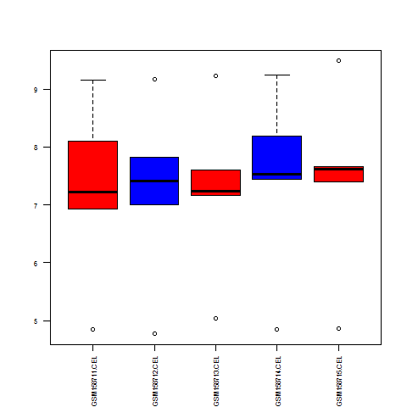
Generate Boxplot
boxplot(join.dat)
boxplot(join.dat, las=2)
boxplot(join.dat, las=2, cex.axis=0.8)
boxplot(join.dat, las=2, cex.axis=0.7, col=c("red, “blue”"))

Slide 16
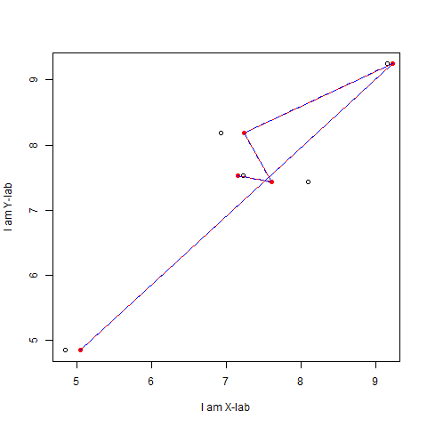
Scatter plot with connecting lines
plot(join.dat[,1], join.dat[,4], xlab="I am X-lab", ylab="I am Y-lab")
points(join.dat[,3], join.dat[,4])
points(join.dat[,3], join.dat[,4], col="red", pch=16)
lines(join.dat[,3], join.dat[,4], col="red", pch=16)
lines(join.dat[,3], join.dat[,4], col="blue", pch=16, lty="dashed")

Slide 17
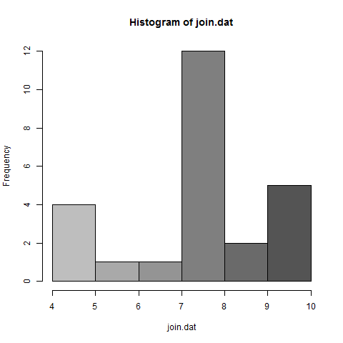
A histogram of all the probes intensity
join.dat=as.matrix(join.dat)
hist(join.dat)
hist(join.dat, col=colorpanel(10,"grey", "black"))

Slide 18
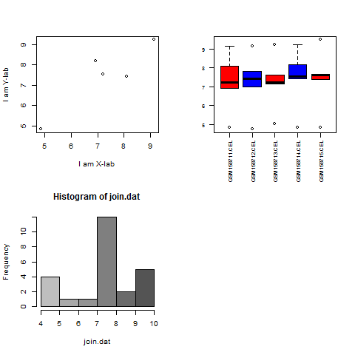
Multiple Plots Together
par(mfrow=c(2,2))
plot(join.dat[,1], join.dat[,4], xlab="I am X-lab", ylab="I am Y-lab")
boxplot(join.dat, las=2, cex.axis=0.7, col=c("red", "blue"))
hist(join.dat, col=colorpanel(10,"grey", "black"))

Slide 19
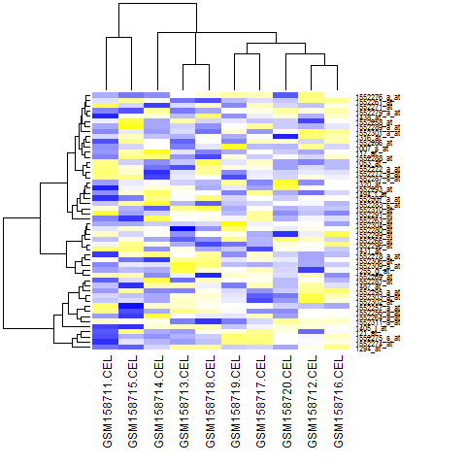
Heatmap
heatmap(join.dat)
heatmap(join.dat, col=colorpanel(100, "blue", "white", "yellow"))
heatmap(join.dat, col=colorpanel(100, "blue", "white", "yellow"), margin=c(10,10))
heatmap(as.matrix(in.data[1:50,]), col=colorpanel(100, "blue", "white", "yellow"), margin=c(10,10))

Slide 20
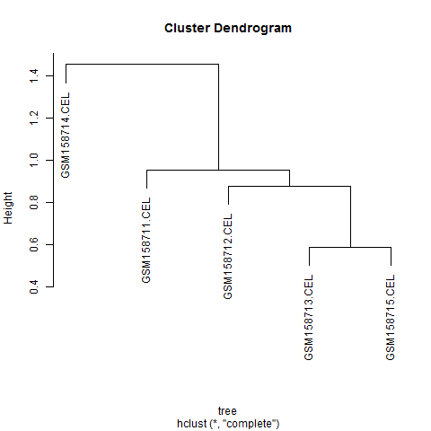
Hierachical Cluster Tree
dist(join.dat)
t(join.dat)
tree=dist(t(join.dat))
hclust(tree)

Slide 21
Exercise
Let’s generate boxplots and figures for the expression patterns of all the cell cycle genes located on chr17
The probe/Gene name file is at:
/apps/ComputingBasics/cellcycle.chr17.txt

Slide 22
Just to get you start
# set target file and read in
gexp.file="C:\\Users\\Yaoyu\\Desktop\\ComputingBasics\\example.rma.cll.txt"
gexp=read.table(gexp.file, header=TRUE, sep="\t")
# set probe file and read in
probe.file="C:\\Users\\Yaoyu\\Desktop\\ComputingBasics\\cellcycle.chr17.txt"
probe=read.table(probe.file, header=TRUE, sep="\t")

Slide 23
# Extract Target Probes from the gene expression matrix
cgexp=gexp[rownames(gexp) %in% probe[,1],]
png(file="boxplot.png")
boxplot(cgexp, las=2, cex.axis=0.7, col=c("red", "blue"))
dev.off()
cgexp=as.matrix(cgexp) # we can change the data type
png(file="hist.png")
hist.info=hist(cgexp, col=colorpanel(10,"grey", "black"))
dev.off()
#Heatmap
png("heatmap.png")
heatmap(cgexp, col=colorpanel(100, "blue", "white", "yellow"), margin=c(10,10))
dev.off()

